Slide 1

Codergirl – Frontend
Unit 2 - Class 4
December 9, 2020
Notes:
1

Slide 2
Agenda
Section 6
Adding Navigation with ngIf and Event Binding. (85)
Passing Recipe Data with Property Binding. (86)
Passing Data with Event and Property Binding (87)
Allowing the User to Add Ingredients to the Shopping List (89)
Notes:
2

Slide 3
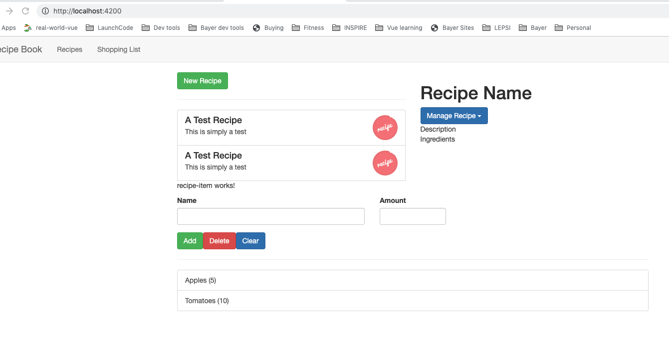
Adding Navigation with ngIf and Event Binding. (85)
app – we want to conditional logic to only load one of the two sections between recipes and shopping based on header clicked (emit event)
Notes:
3

Slide 4
Adding Navigation with ngIf and Event Binding. (85)
Breakout rooms to work on the solution – 15 mins
Notes:
4

Slide 5
Adding Navigation with ngIf and Event Binding. (85)
header-component.ts
Notes:
5

Slide 6
Adding Navigation with ngIf and Event Binding. (85)
header-component.html
Notes:
6

Slide 7
Adding Navigation with ngIf and Event Binding. (85)
app-component.html
app-component.ts
Notes:
7

Slide 8
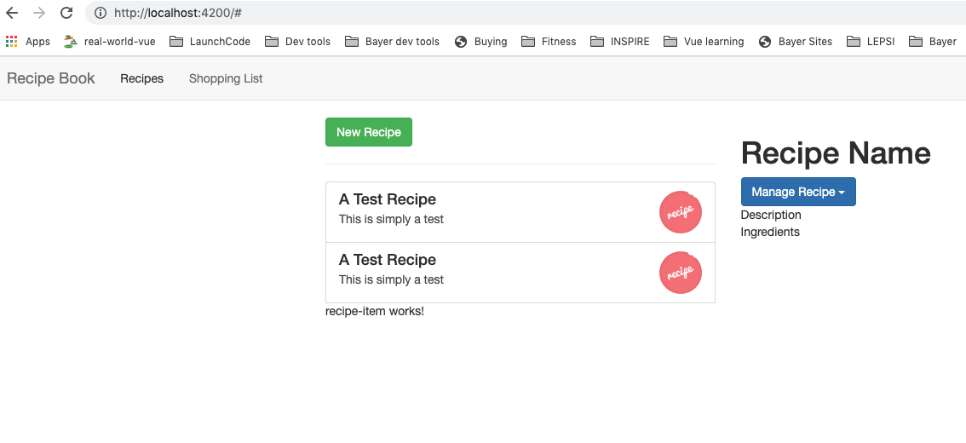
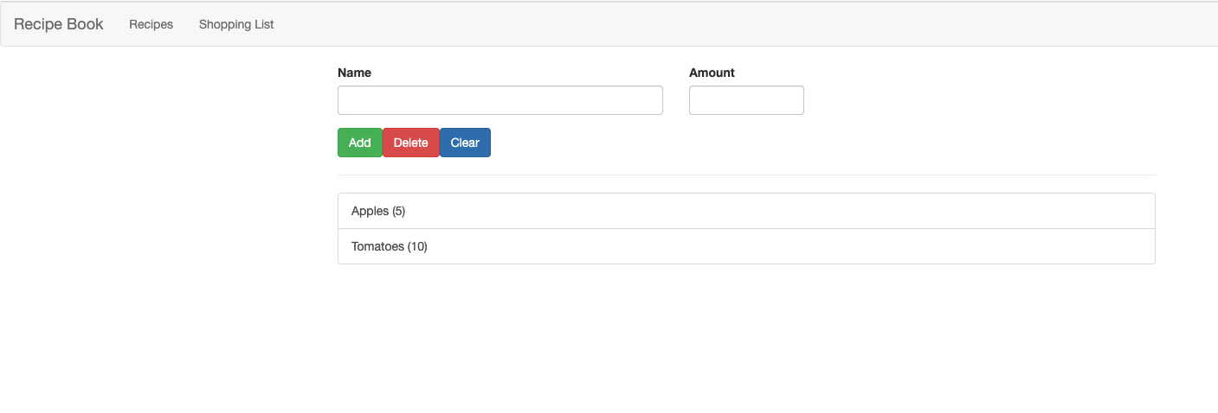
Adding Navigation with ngIf and Event Binding. (85)
Notes:
8

Slide 9
2. Passing Recipe Data with Property Binding. (86)
app – we want to move for loop from recipe –item and move it to the recipe-list and pass down single recipe item to recipe-item component and make that work.
Breakout room – 15 mins
Notes:
9

Slide 10
2. Passing Recipe Data with Property Binding. (86)
recipe-list.component.html
Notes:
10

Slide 11
2. Passing Recipe Data with Property Binding. (86)
recipe-item.component.ts
Notes:
11

Slide 12
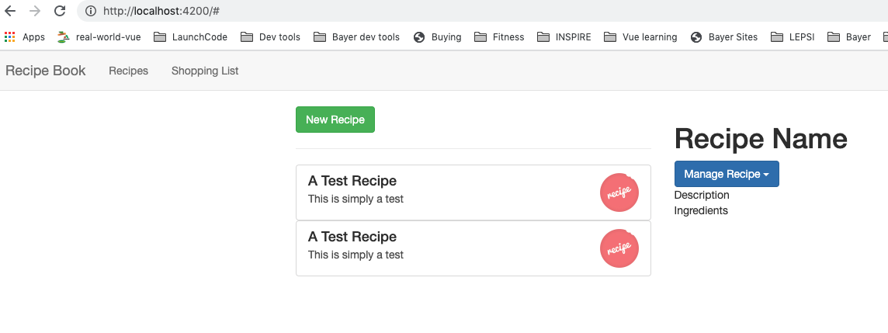
2. Passing Recipe Data with Property Binding. (86)
Notes:
12

Slide 13
3. Passing Data with Event and Property Binding (87)
Goal: Click on each recipe item to load recipe details
Emit event on recipe item that it was clicked (click listener for recipe item), to get event to recipe detail to pass down which recipe was clicked to component
Property and Event binding.
Breakout room : 20 mins
Notes:
13

Slide 14
3. Passing Data with Event and Property Binding (87)
recipe-item.component.html
Notes:
14

Slide 15
3. Passing Data with Event and Property Binding (87)
recipe-item.component.ts
Notes:
15

Slide 16
3. Passing Data with Event and Property Binding (87)
recipe-list.component.html
Notes:
16

Slide 17
3. Passing Data with Event and Property Binding (87)
recipe-list.component.html
Notes:
17

Slide 18
3. Passing Data with Event and Property Binding (87)
Notes:
18

Slide 19
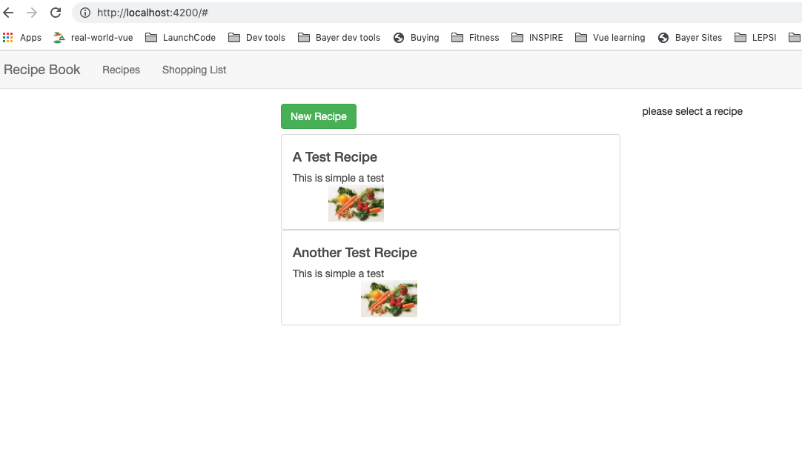
3. Passing Data with Event and Property Binding (87)
Notes:
19

Slide 20
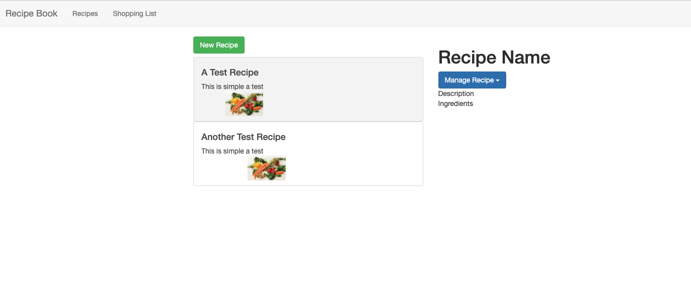
3. Passing Data with Event and Property Binding (87)
Notes:
20

Slide 21
3. Passing Data with Event and Property Binding (87)
Notes:
21

Slide 22
3. Passing Data with Event and Property Binding (87)
Notes:
22

Slide 23
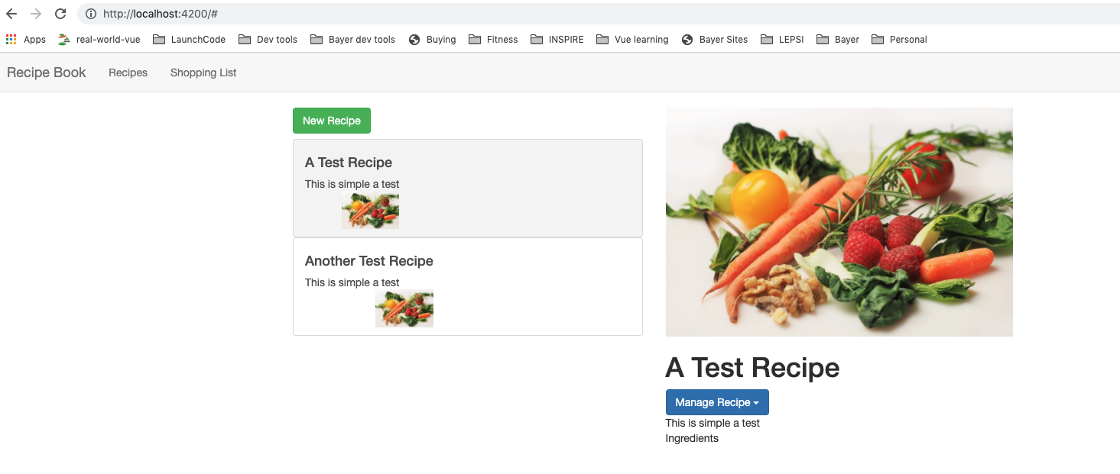
3. Passing Data with Event and Property Binding (87)
Notes:
23

Slide 24
Add FormsModule to AppModule
Notes:
24

Slide 25
4. Allowing the User to Add Ingredients to the Shopping List (89)
localReference for nameInput and
amountInput
Pass them as argument or addViewChild
Emit event
Breakout room – 20 mins.
Notes:
25

Slide 26
4. Allowing the User to Add Ingredients to the Shopping List (89)
Notes:
26

Slide 27
4. Allowing the User to Add Ingredients to the Shopping List (89)
Notes:
27

Slide 28
4. Allowing the User to Add Ingredients to the Shopping List (89)
Notes:
28

Slide 29
4. Allowing the User to Add Ingredients to the Shopping List (89)
Notes:
29

Slide 30
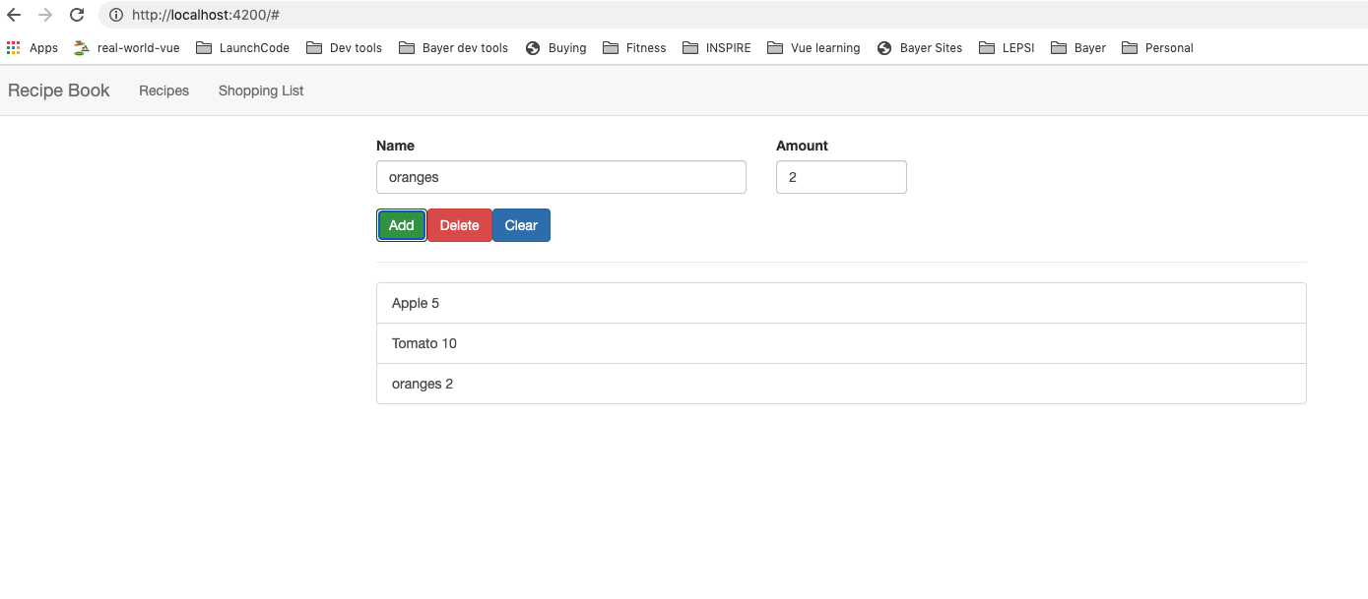
Finished app…so far!

Slide 31
Questions?

